Slide 1
INTRODUCTION BACKGROUND
50 Million People
Have epilepsy around the world
9.9 per 1000 People
Prevalence of epilepsy in Pakistan
Risk of Premature Death
3x more than general population
Notes:
https://www.ncbi.nlm.nih.gov/pmc/articles/PMC8794165/

Slide 2
IOT-VISION ENABLED ASSISTANCE FOR EPILEPTIC PATIENTS

Slide 3

TEAM PRESENTATION
Muhammad Ali Murtaza 2020-CS-114
Zeshan Ayub 2020-CS-113
Ali Tariq 2020-CS-142
Syed Azeem Ali Hashmi 2020-CS-156

Slide 4

COST OF ILLNESS (COI)
According to Emory University School of Medicine
 | Cost in Euro (3 Months) | Cost in PKR (3 Months) | Cost in PKR (1 Month)
Focal | €4911 | PKR 15,21,542 | PKR 5,07,180
Genetic Generalized | €2782 | PKR 8,61,928 | PKR 2,87,309
Unclassified Epilepsy | €2598 | PKR 8,04,921 | PKR 2,68,307
Average COI is PKR 3,54,265 !!!
Notes:
https://www.ncbi.nlm.nih.gov/pmc/articles/PMC10131573/

Slide 5
PROBLEM STATEMENT
“
Develop a cost-efficient smart system to monitor daily life activities of elderly epileptic patients for detection, prevention and forecasting of seizures as well as provide useful insights to improve their living standard.
”

Slide 6




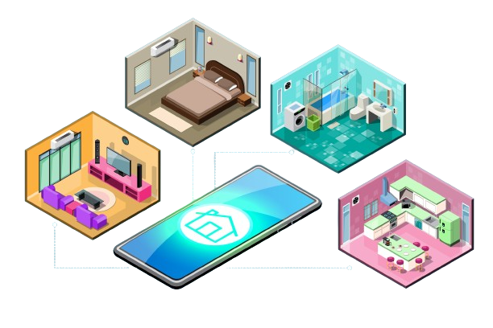
PROPOSED SOLUTION
IoT-Vision Enabled Assistant for Epileptic Patients
Alert in Emergency Situation
Seizure Forecasting
Daily Activity Monitoring
Seizure Detection

Slide 7
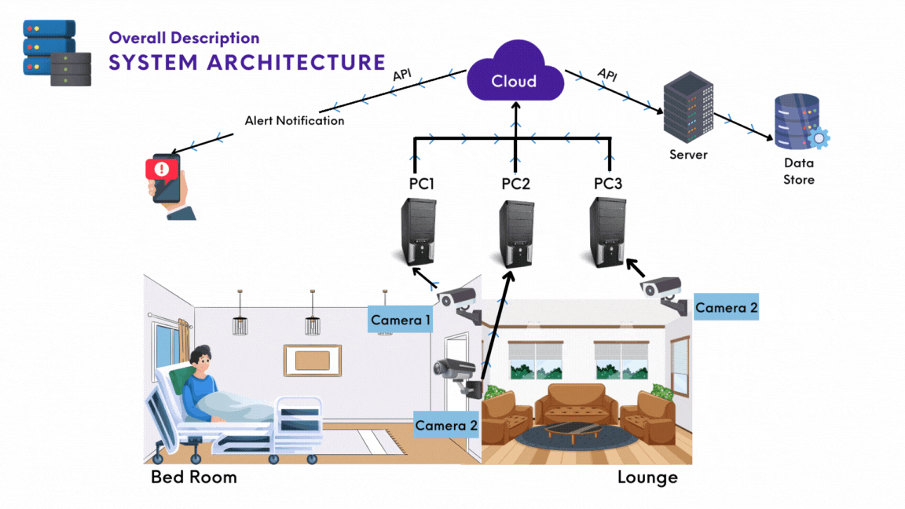
7

Slide 8
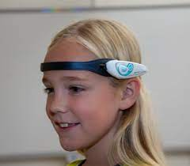
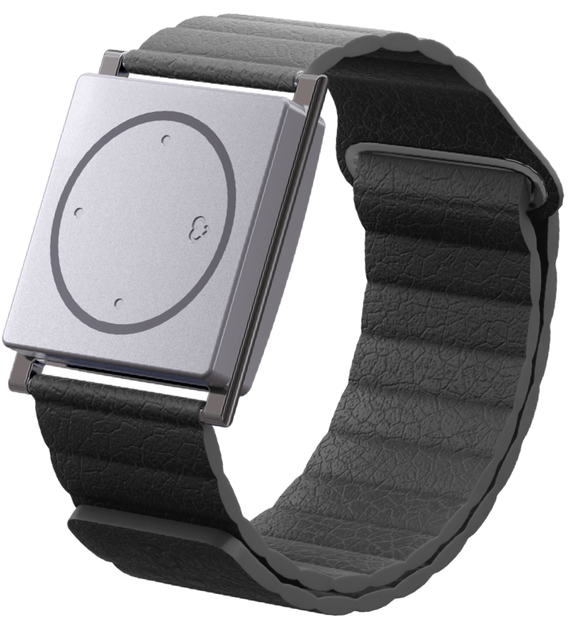
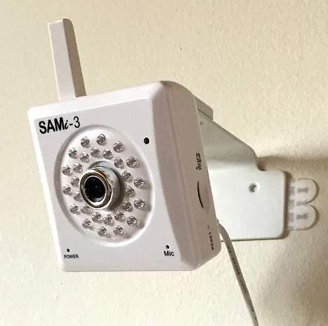
SIMILAR MARKET PROJECTS
Epihunter
Cost: $825.91 – $1,515.91
Detector Location: Scalp
Technique: EEG Signal
Embrace 2
Cost: $249
Subscription: $9.90-$44.90
Detector Location: Wrist
Technique: Sensors
SAMi
Cost: Rs 1,14,00.00
Detector Location: Wall
Technique: Vision

Slide 9

UNIQUE APPLICATION FEATURE
Personalized Machine Learning Approach
Our focus is on personalized model techniques rather than a one-fit-all approach.

Slide 10






APPLICATION AREAS
01
02
03
HOME HEALTHCARE
HOSPITALS
CARE CENTERS
04
05
06
REMOTE MONITORING
RESEARCH AND DEV
WORKPLACE SAFETY

Slide 11

CONCEPT VIDEO

Slide 12
THANKS!

